Slide 1

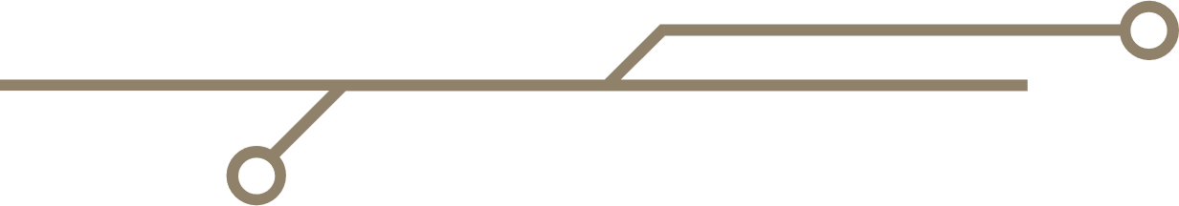
Athena-CTI-LLM

Slide 2

Data Gathering & Preprocessing Pipeline
Following are the steps that are included in data gathering and preprocessing pipeline:
Data Gathering: Collect data from Cybersecurity websites.
Data Filter: Filters and only keeps useful data related to CTI.
Structured Data: Generate Question-Answer pairs from filtered data.
Domain Classification: Classifies data in relevant cybersecurity categories.
Manual Review: Human review of Instruction-response pairs.
Security Alignment: Enhance dataset with real scenarios.
Final Assembler: Merges final data, removes duplicates.
Data Gathering
Data Filter
Structured Data
Domain Classification
Manual Review
Security Alignment
Final Assembler

Slide 3
LLM Fine Tuning
Following are the steps that are included in LLM Fine Tuning:
Design: Architecture, Objectives, and Scope for Athena-CTI-LLM.
Data Preparation: Collect and prepare data as proposed in our data processing pipeline.
Pre-training: Train the base language model on a large corpus focused on CTI to learn domain-specific patterns.
Fine-Tuning: Use Parameter-Efficient Fine-Tuning (PEFT) to adapt the model for specific CTI tasks with Instruction-Response data.
RLHF (Optional): Apply reinforcement learning with human feedback to refine model responses for better alignment with expert expectations.
Design
Data Preparation
Pre-Training
Fine-Tuning
RLHF

